Slide 1
Lecture 5 Push-down Automata
Push-down automata (PDA),
their equivalence to CFGs, and
non-context-free languages.

Slide 2
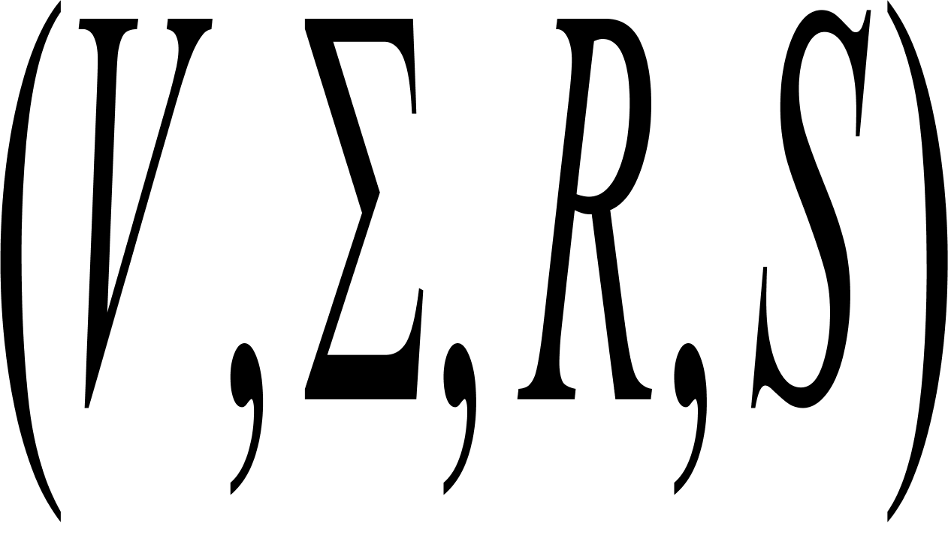

Context free languages
A context free grammar is 4 tuple
where
V is a finite set called the variables,
is a finite set, disjoint from V, called the terminals;
R is a finite set of rules, with each rule being a variable and a string of variables and terminals, and
S is the start variable.

Slide 3

Examples
Consider grammar G4=(V, A, R, <EXPR>).
V is {<EXPR>, <TERM>,<FACTOR>} and A is {a, +, ,() }. The rules are
<EXPR> <EXPR>+<TERM>|<TERM>
<TERM> <TERM> <FACTOR>|<FACTOR>
<FACTOR> (<EXPR>)|a
Construct the parse tree for the strings a+a a, (a+a) a

Slide 4
PDA: an extension of FA (in what sense)
Stack: “ last in,first out”
X
y
z
Infinite memory
Finite
State Control
a a a a
input
FA
PDA
Example: {0^n1^n: n>=0}

Slide 5
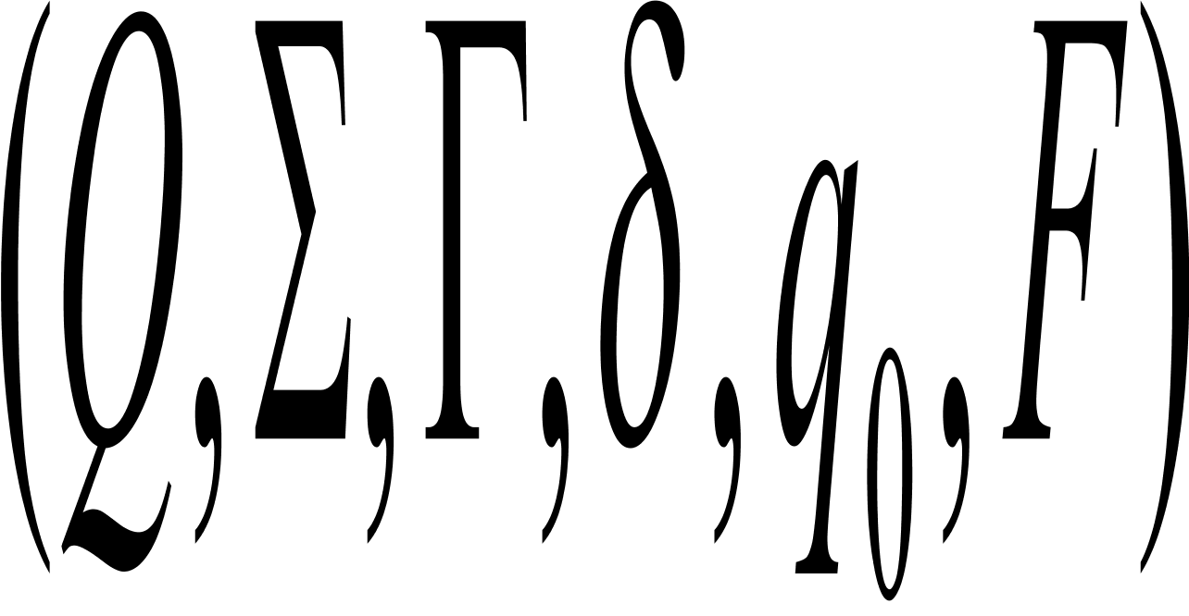
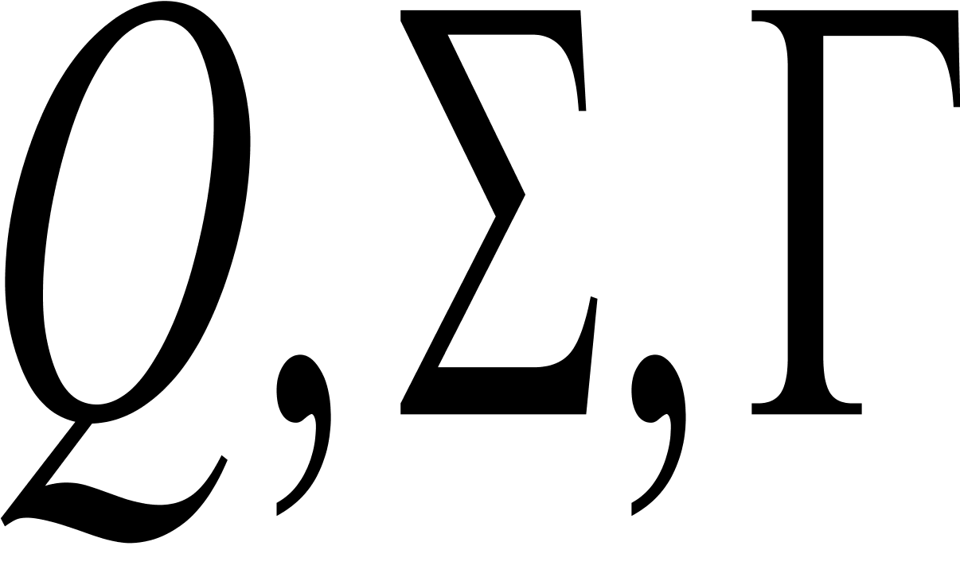

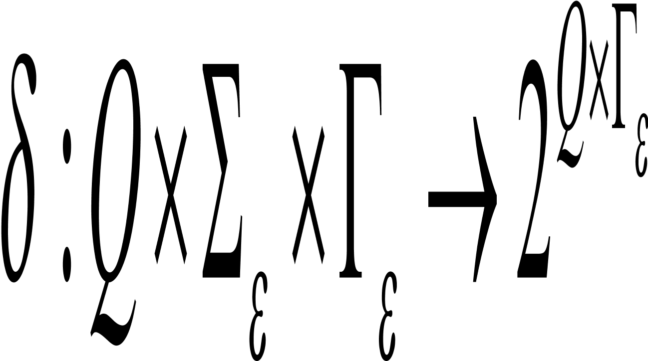

Definition
A push-down automaton (PDA) is 6 tuple ,where are finite
Q is the set of states;
is the input alphabet;
is the stack alphabet;
is the transition function;
is the start state;
F is the set of accept states.
What is the essential difference from NFA?

Slide 6
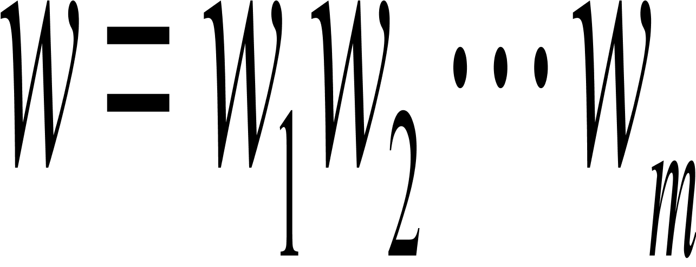
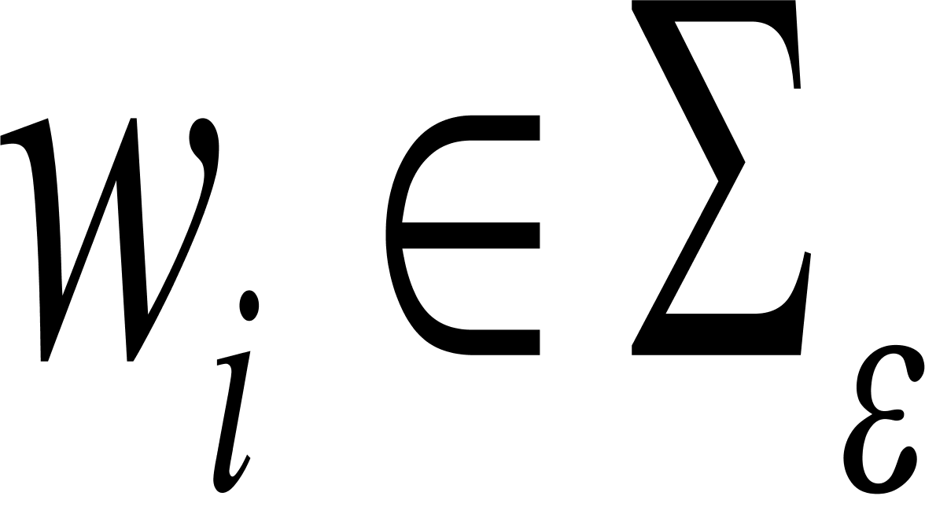
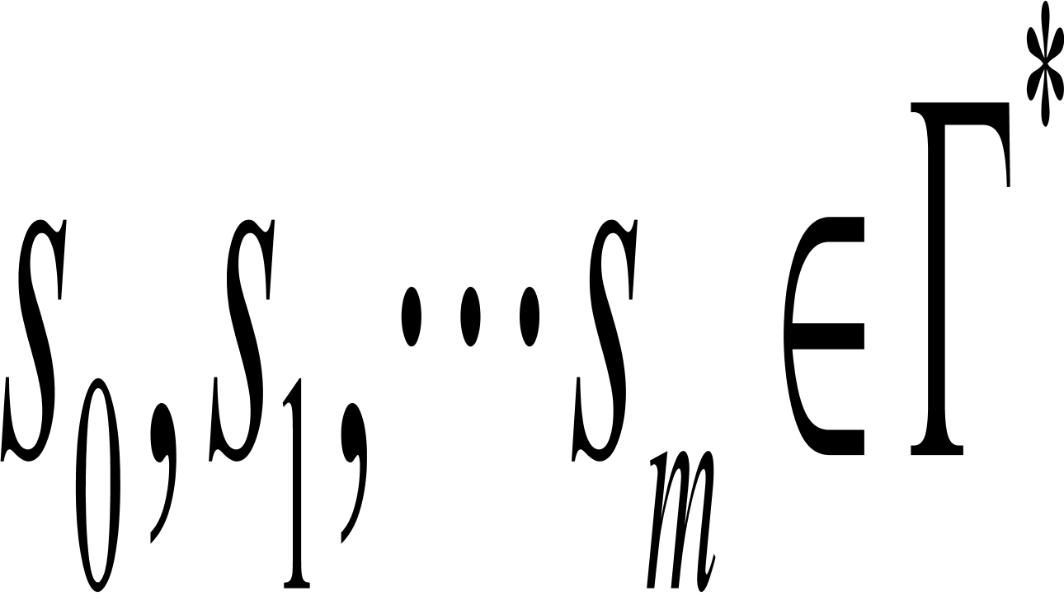
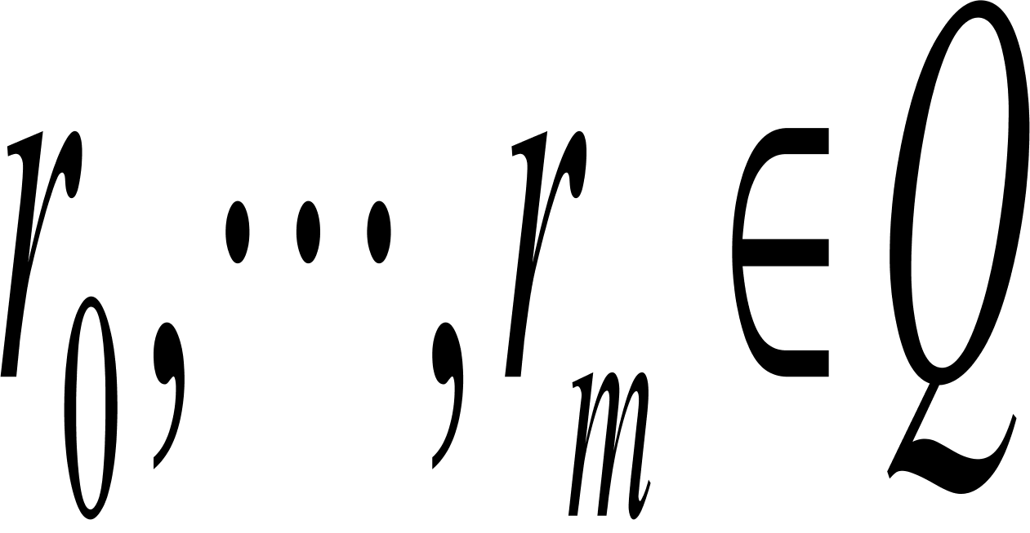
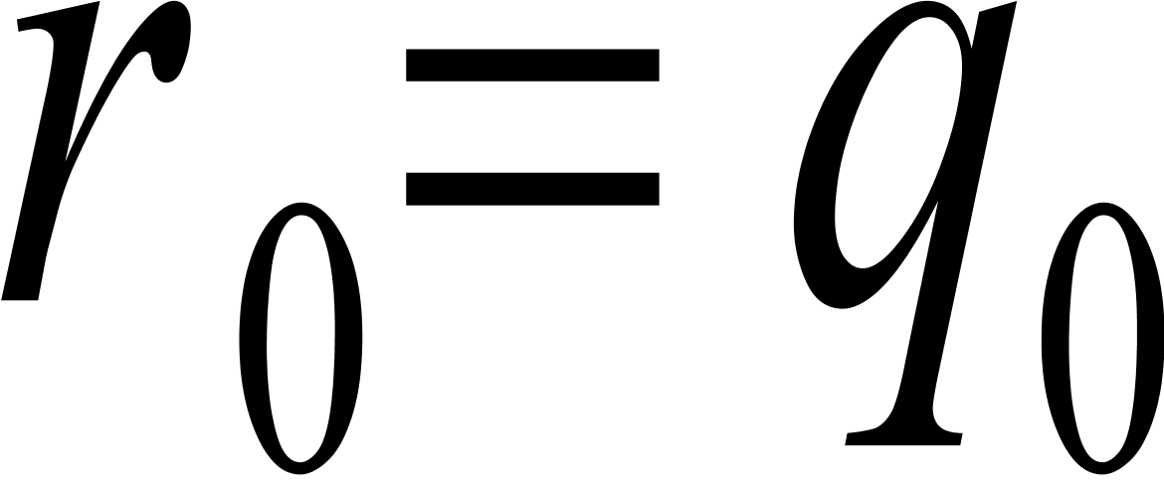
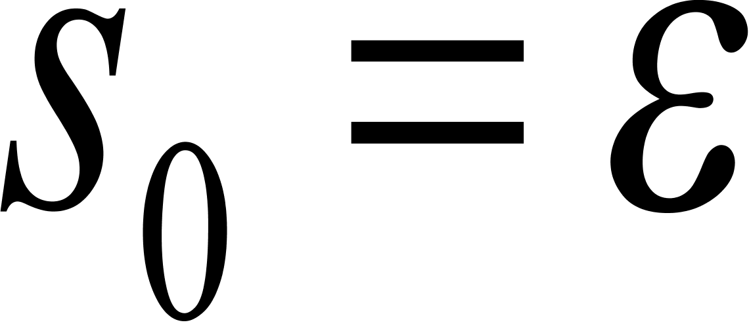
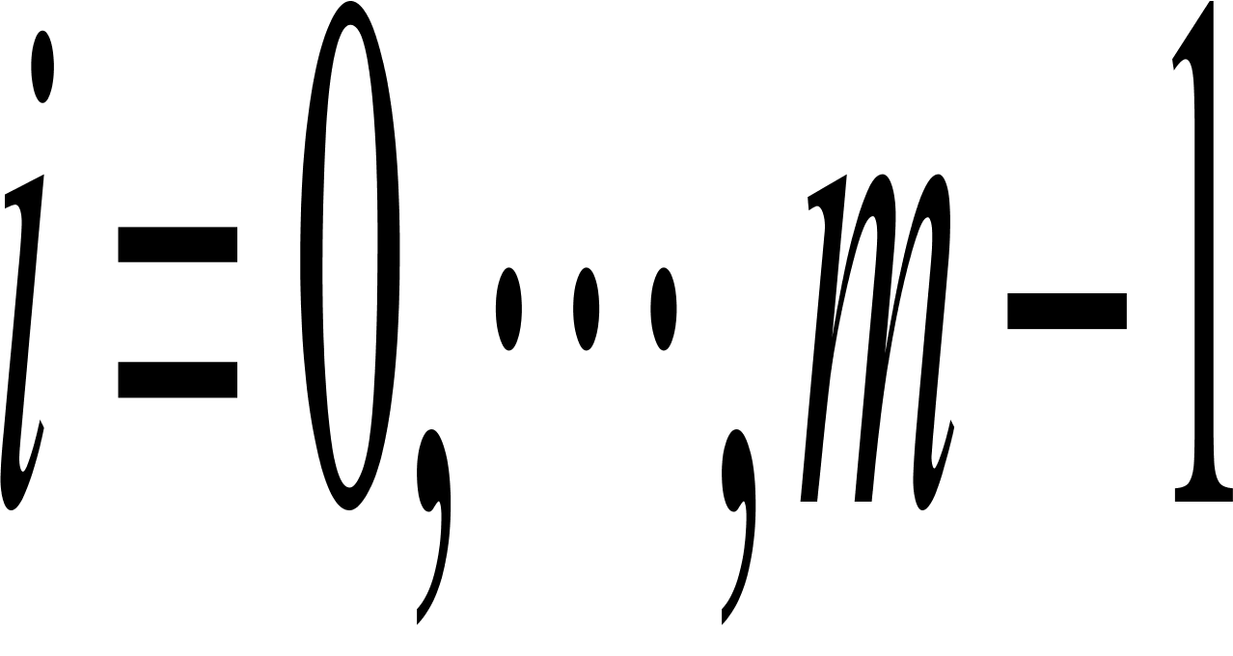
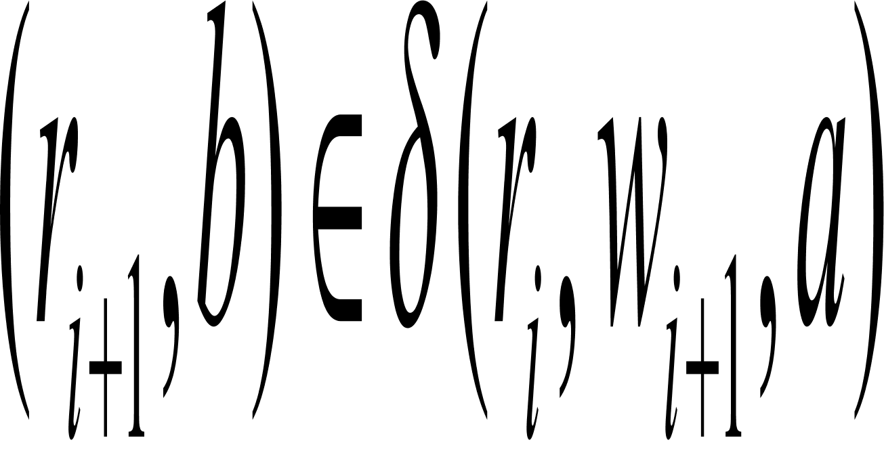
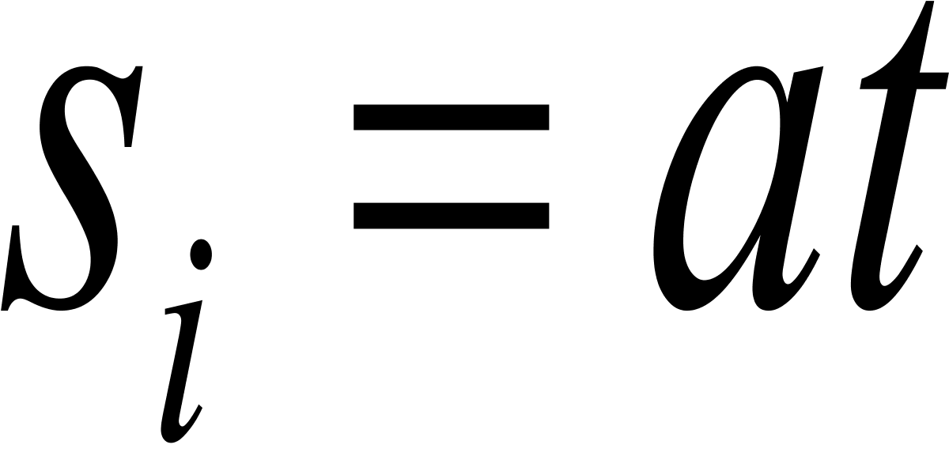
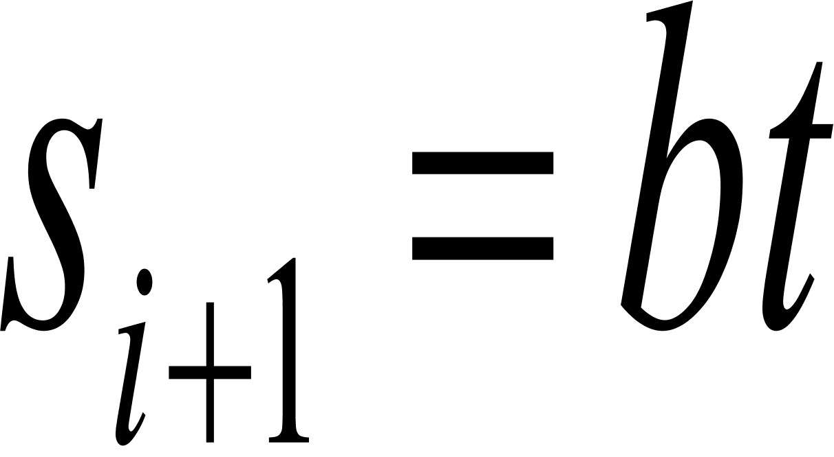
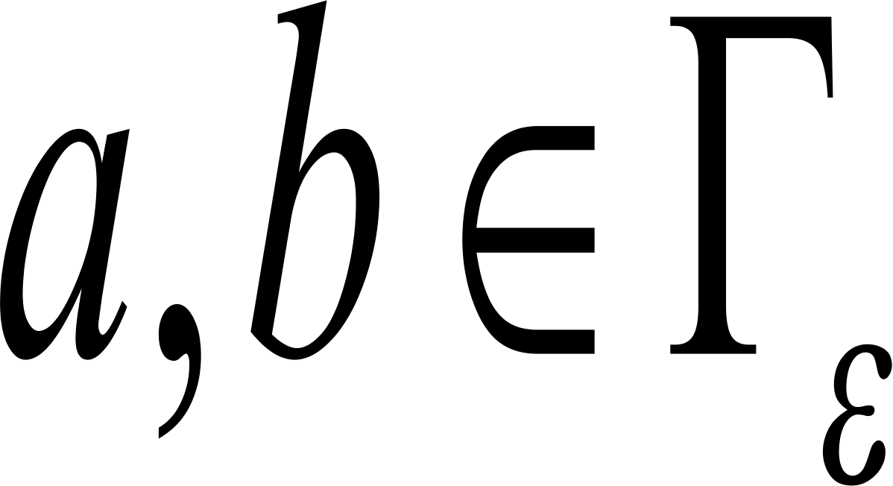
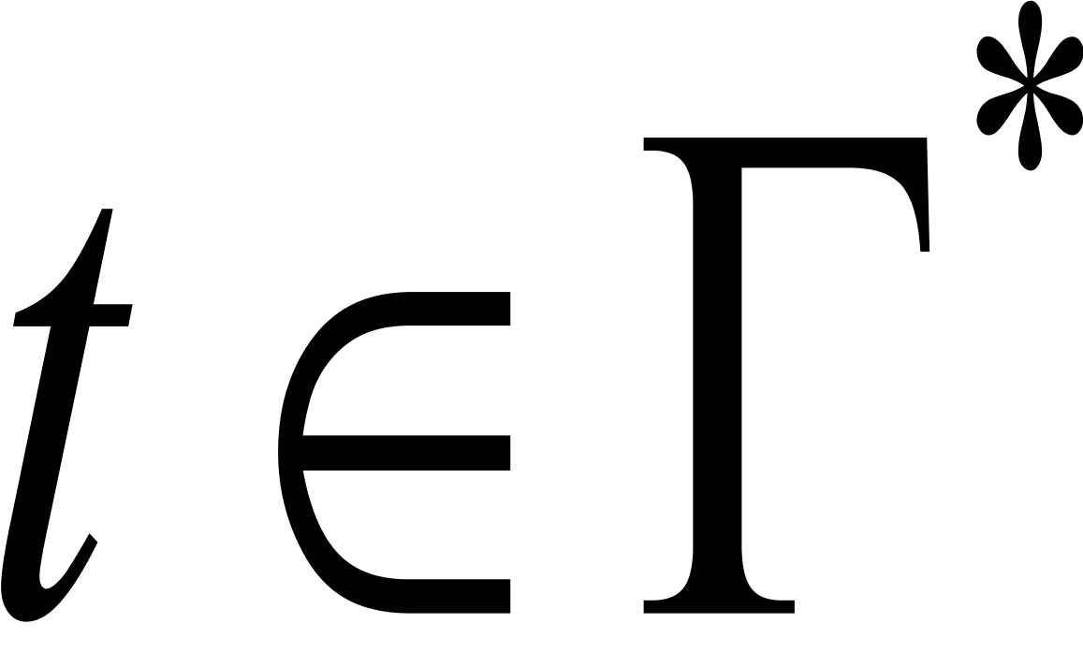
Computations of PDAs
A PDA M accepts input w if w can be written as where and sequences of states and strings exist that satisfy the following conditions:
and ;
For , we have where and for some and
rm is an accept state.
Acceptance by final state
Computations,Derivations and Proofs

Slide 7
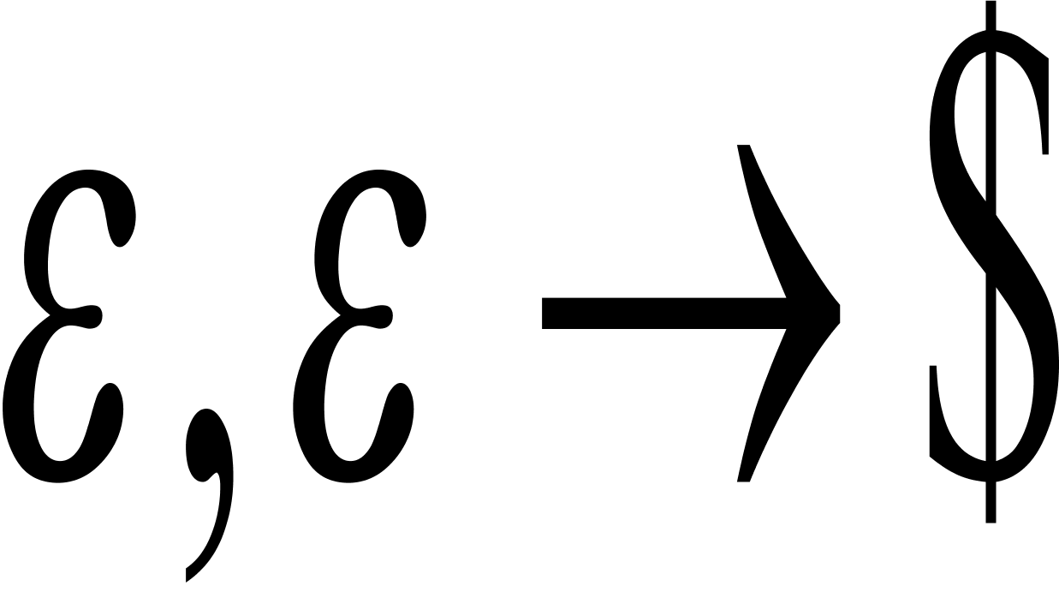
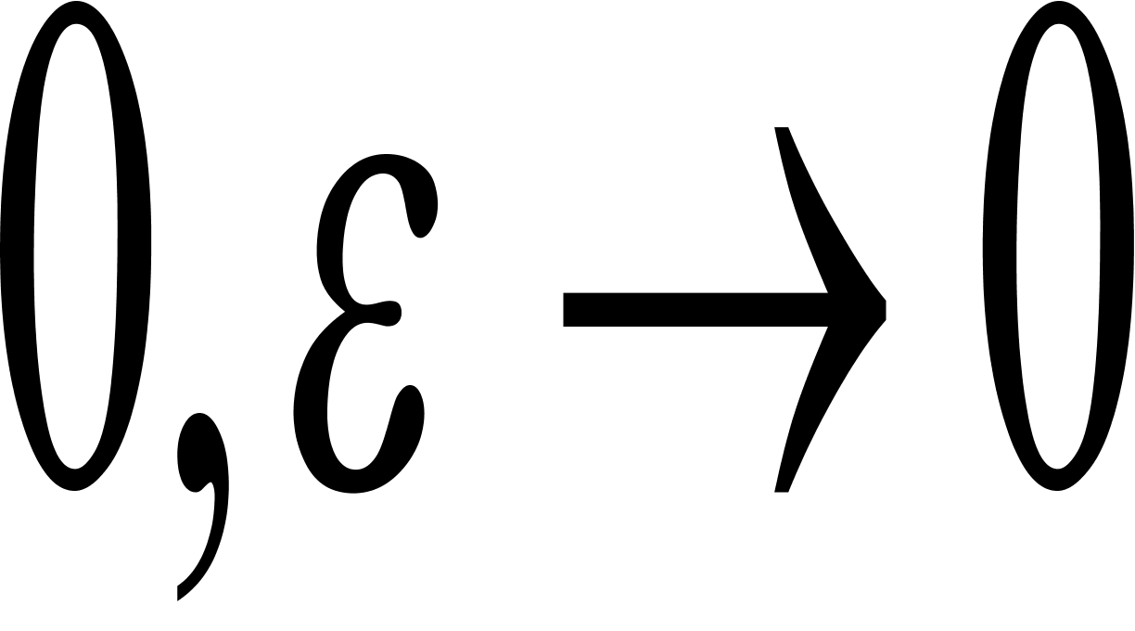
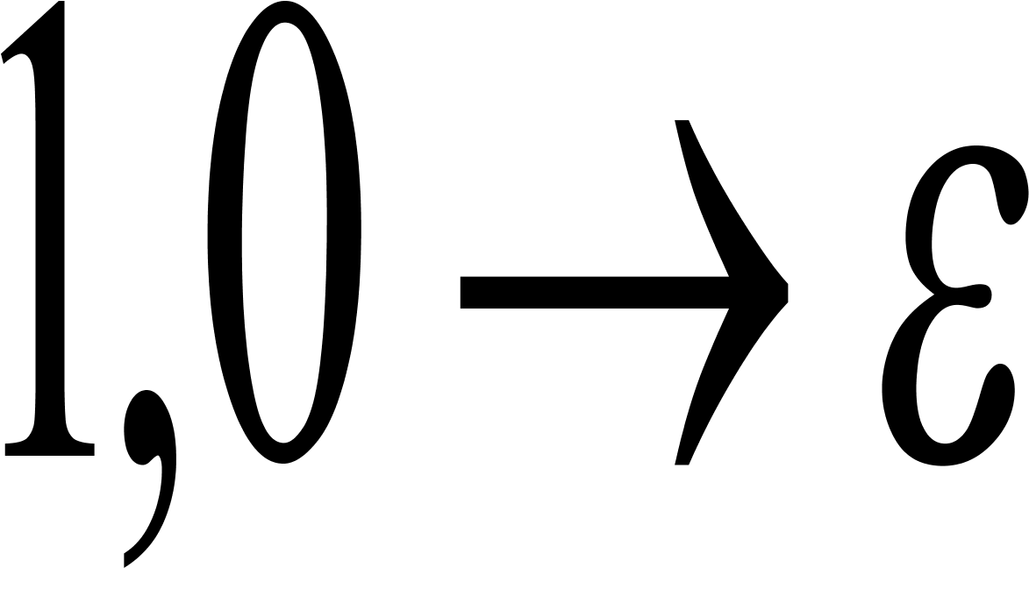
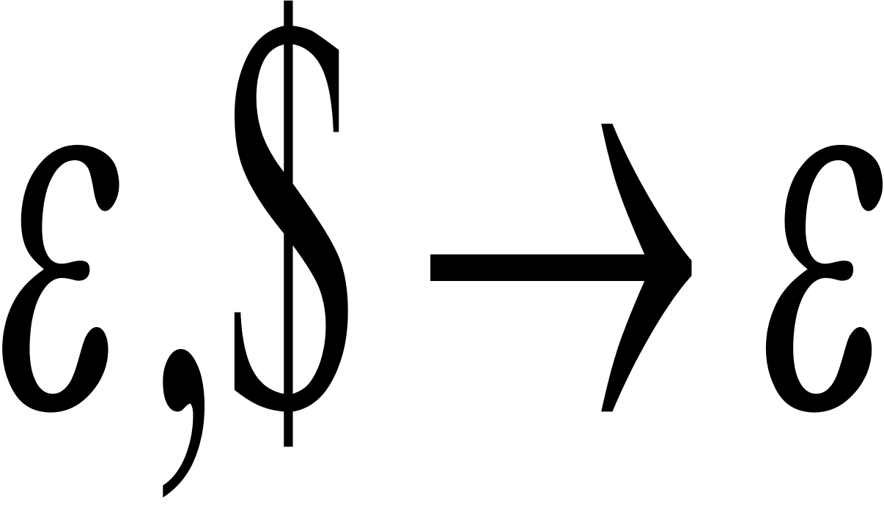
Example
a,b c signifies that when M is reading a from the input,
it may replace b on the top of stack with a c.

Slide 8
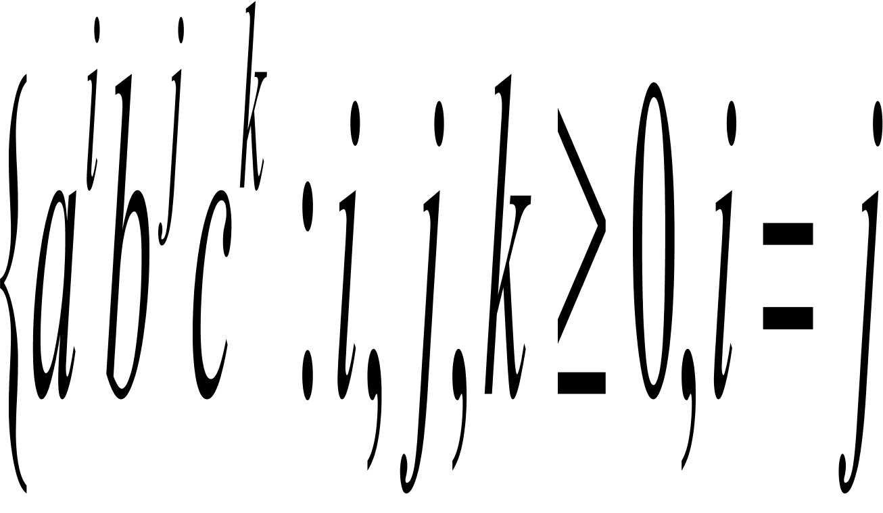
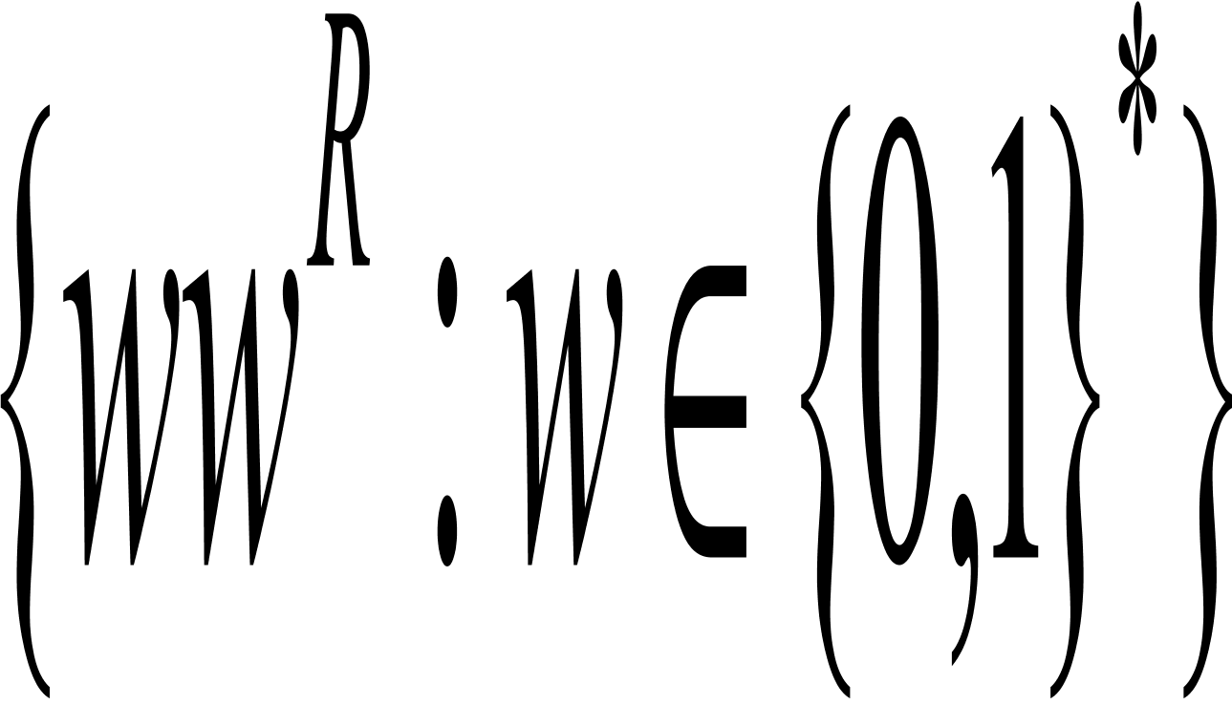
Design PDAs
Design PDAs recognizing the following languages
The language or i=k}
Make FULL use of nondeterminism!

Slide 9
CFLs are recognized by PDAs
If a language is context free, then some PDA recognizes it.
Proof idea: A
q
q
B
a,s z
a,s z
qstart
C
q
q
q1
1
a
b
2
e,e S$
e,e y
qloop
a,s xyz
q2
e,A w for rule A w
a,a e for terminal a
r
r
r
e,e x
e,$ e
qaccept
Main State Diagram
Intermedite strings

Slide 10
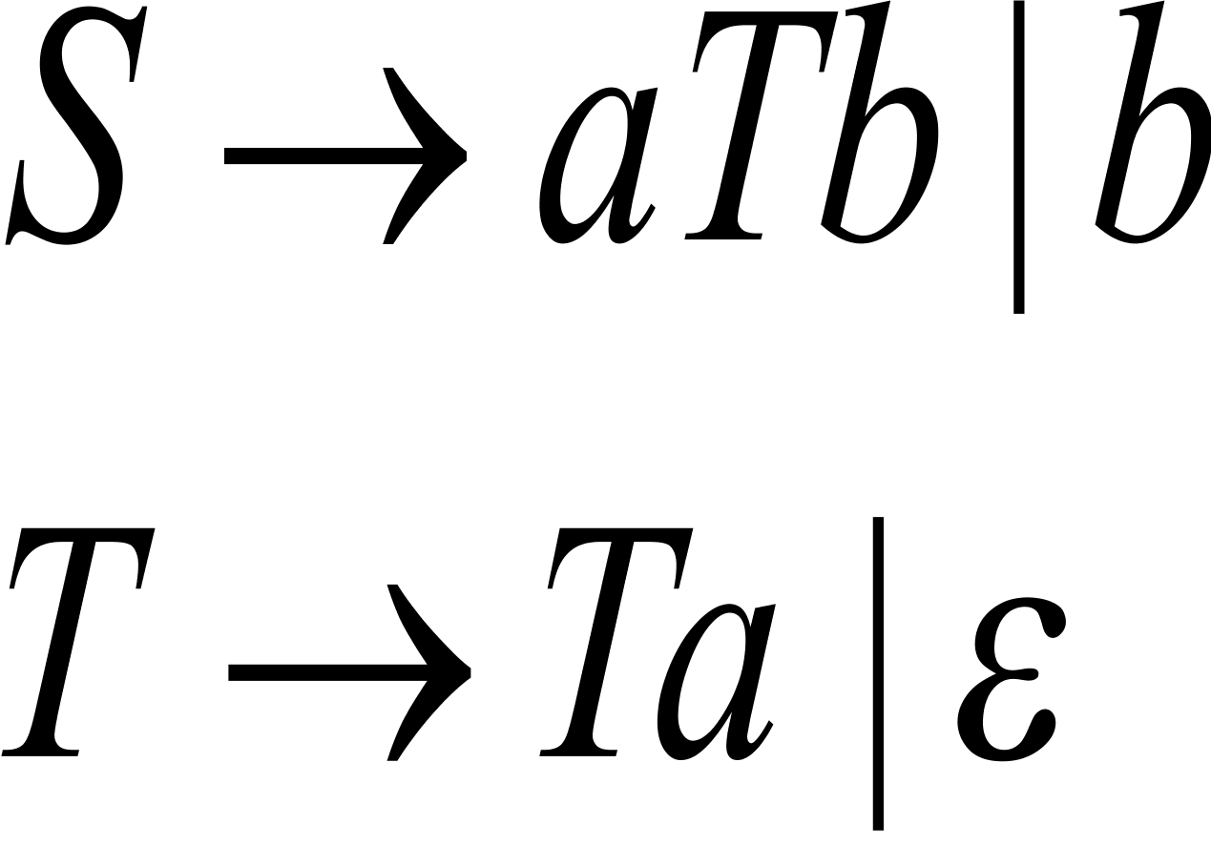
Example
Use the above procedure to construct a PDA from the following CFG:

Slide 11
PDAs imply CFGs: harder direction
If a PDA recognizes some language, then it is context free.
Two small surgeries before proof:
Modify PDA P by imposing three features
It has a single accept state;
It empties its stack before accepting;
Each transition either pushes a symbol or pops one off the stack, but does not do both simultaneously.
If a string x can take P from p with an empty stack to q with an empty stack, x can also take P from p to q, regardless of the stack content.

Slide 12

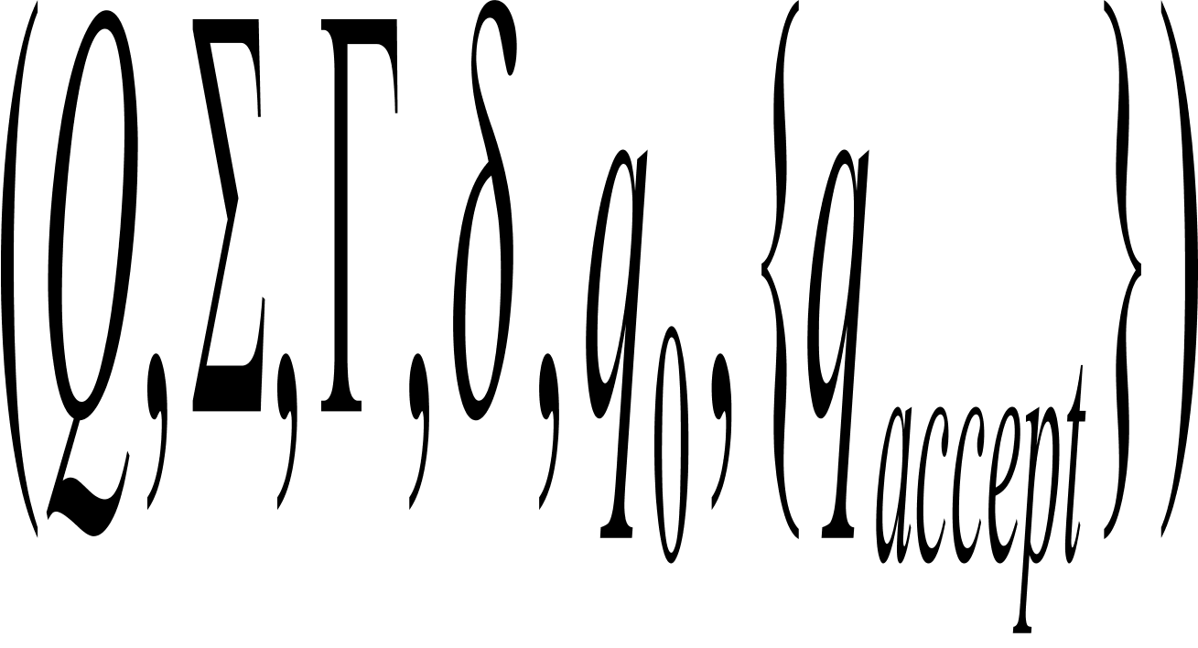
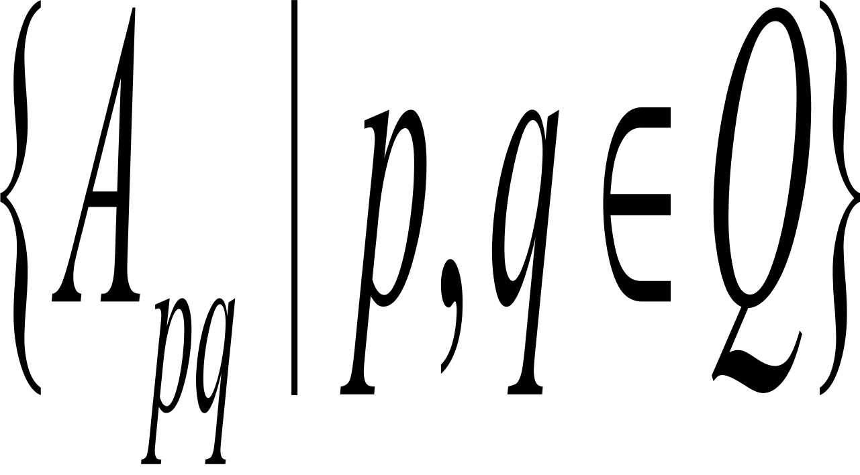
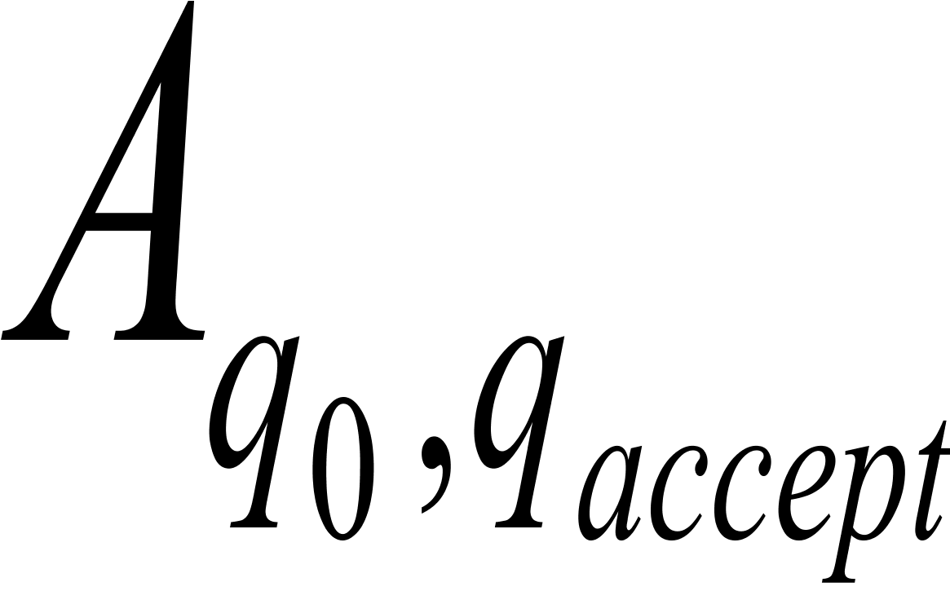
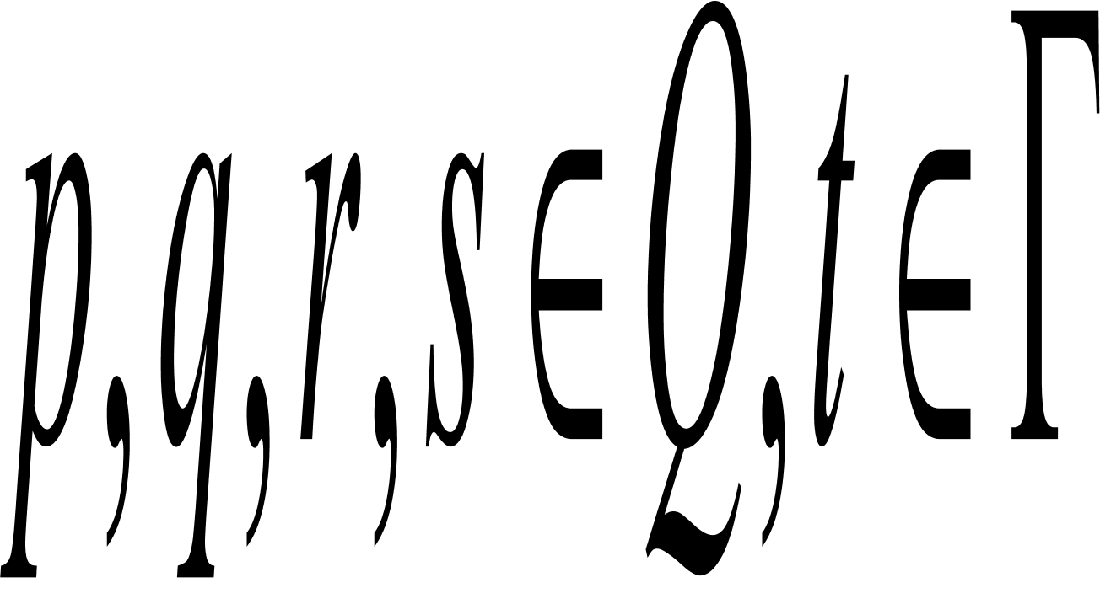
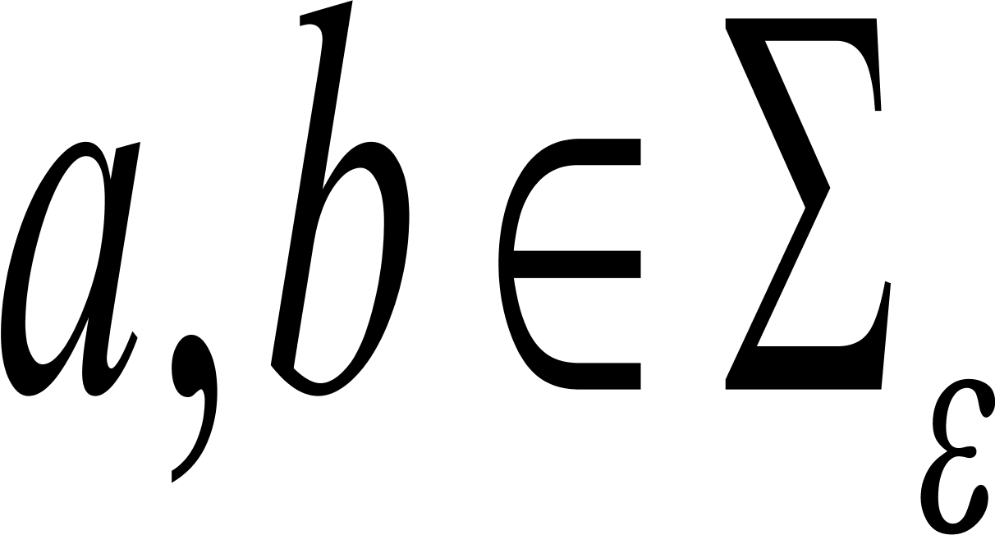
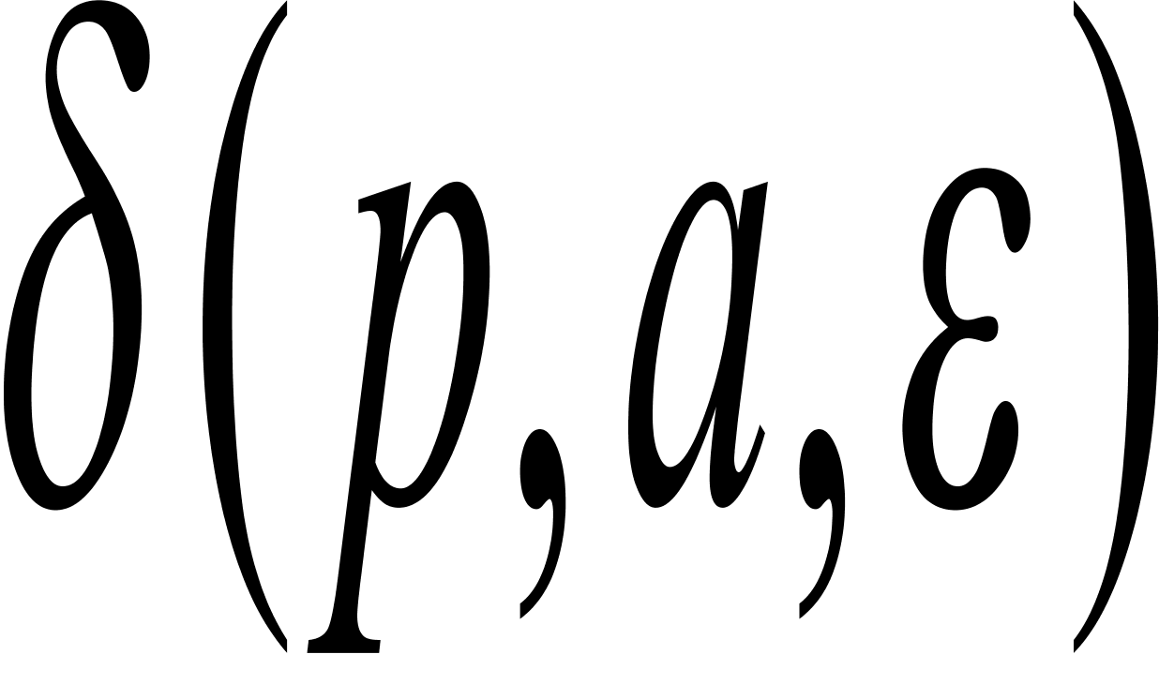
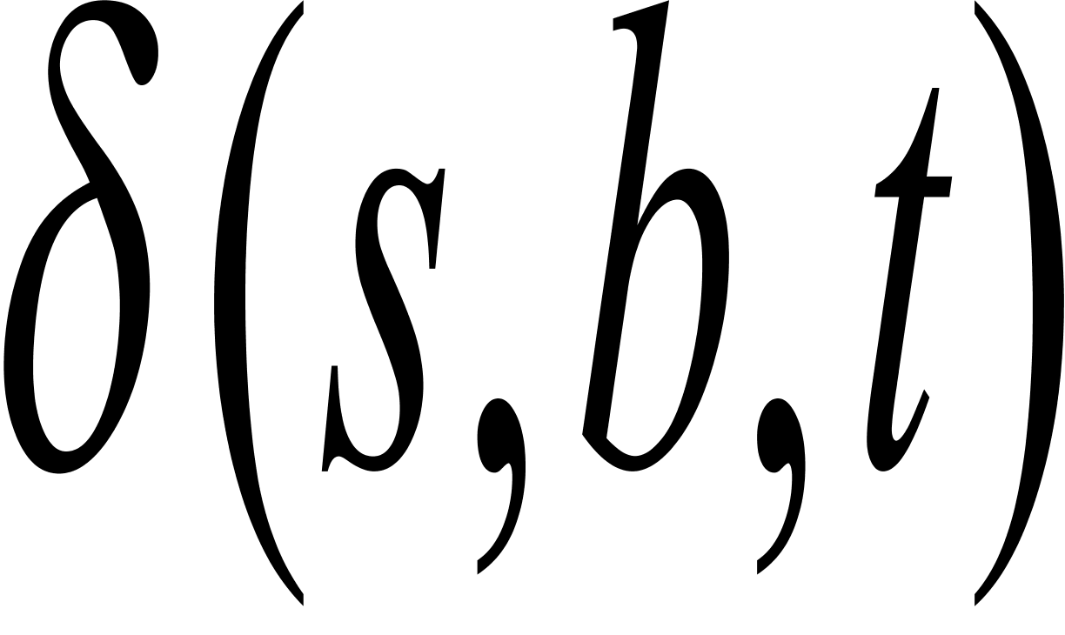
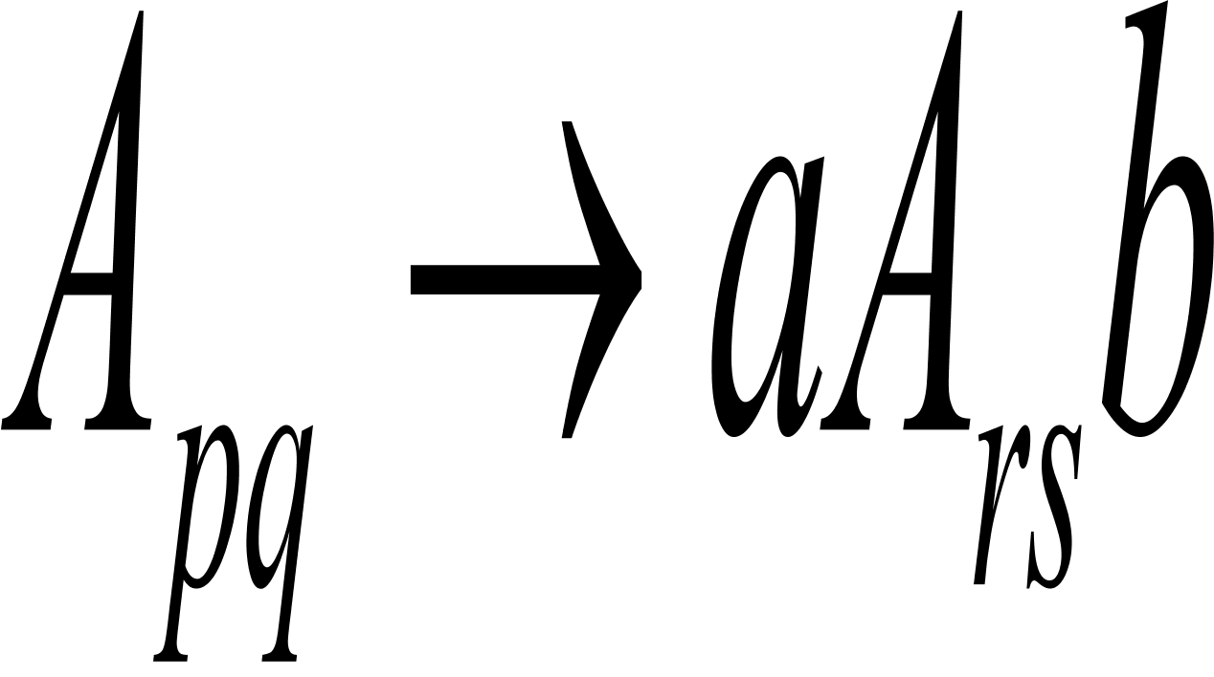
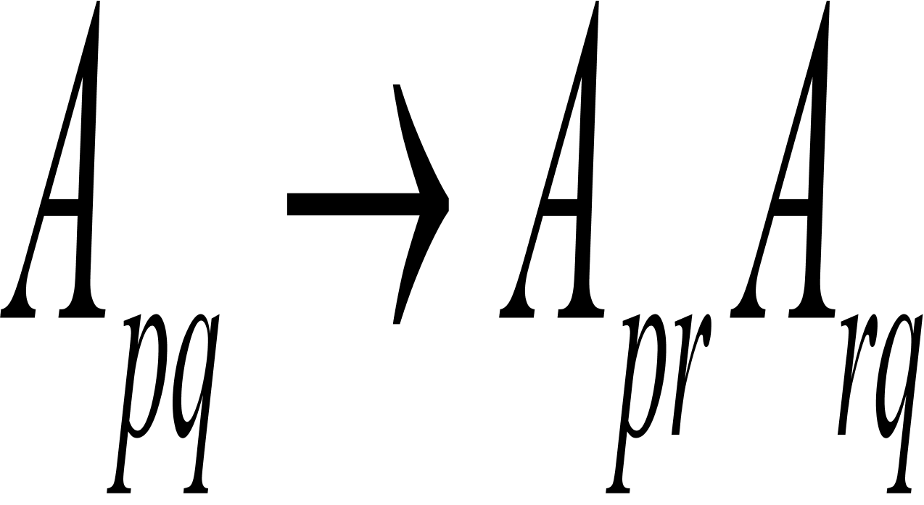
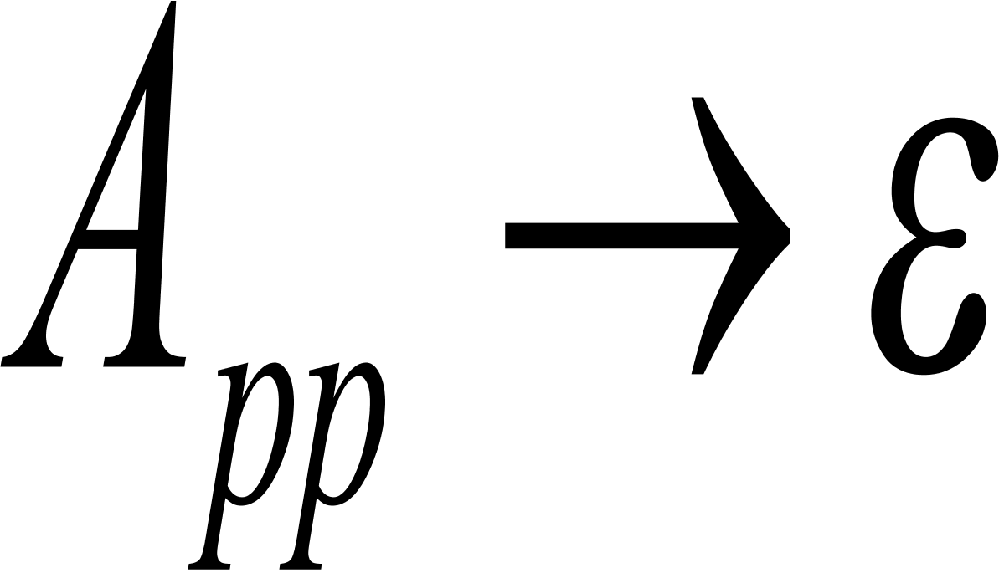
PDAs imply CFGs: harder direction
If a PDA recognizes some language, then it is context free.
Proof Idea: Consider a PDA
The variables of G are .The start
variable is .Specify the rules of G as follows:
For each and if contains(r,t) and contains (q,e),put the rule in G.
For each p,q,r in Q, put the rule in G
For each p in Q, put the rule in G

Slide 13
Intuition behind the construction
Stack
Height
s
r
p
q
Input string
p
r
q
a
b
Generated
by Ars
Generated by Ars
Generated
by Apr
Generated by Apq
Generated by Apq
Apq generates x iff x can bring P from p with empty stack
To q with empty stack.

Slide 14
Example: Converting PDAs into CFGs
a,b c signifies that when M is reading a from the input,
it may replace b on the top of stack with a c.

Slide 15
Order of the simplification
Converting to Chomsky normal form:
Firstly eliminate the epsilon-rules;
Secondly eliminate the unit rules;
Last eliminate useless symbols.

Slide 16
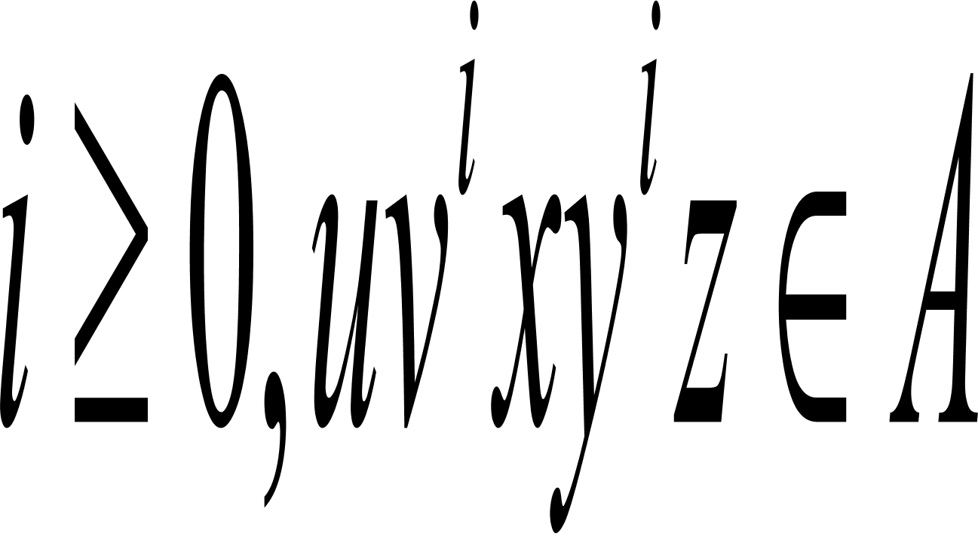
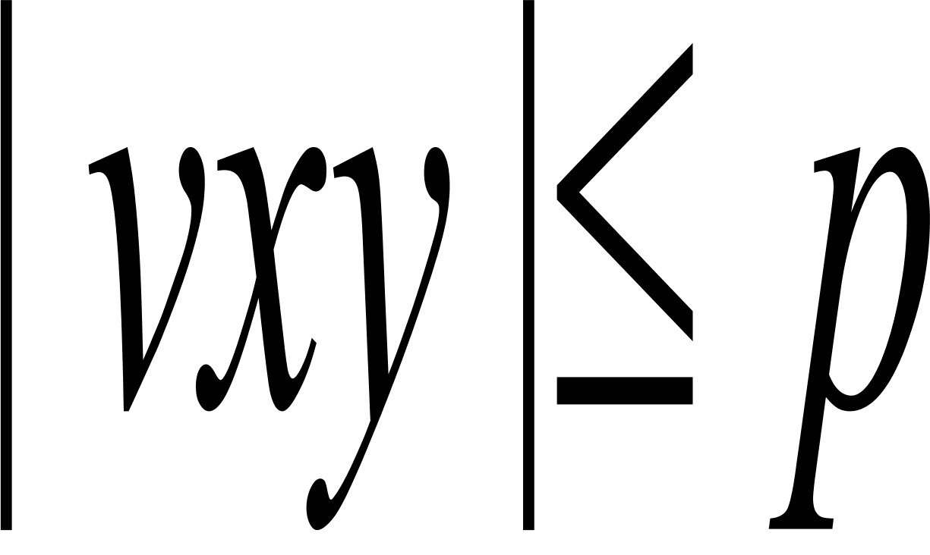
Non-Context-free languages
Pumping Lemma: If A is a CFL, there exists a pumping length p such that, if s is a string in A of length at least p, then it can be divided into s=uvxyz satisfying the following conditions:
For each
|vy|>0;
.
Necessary condition!!!

Slide 17
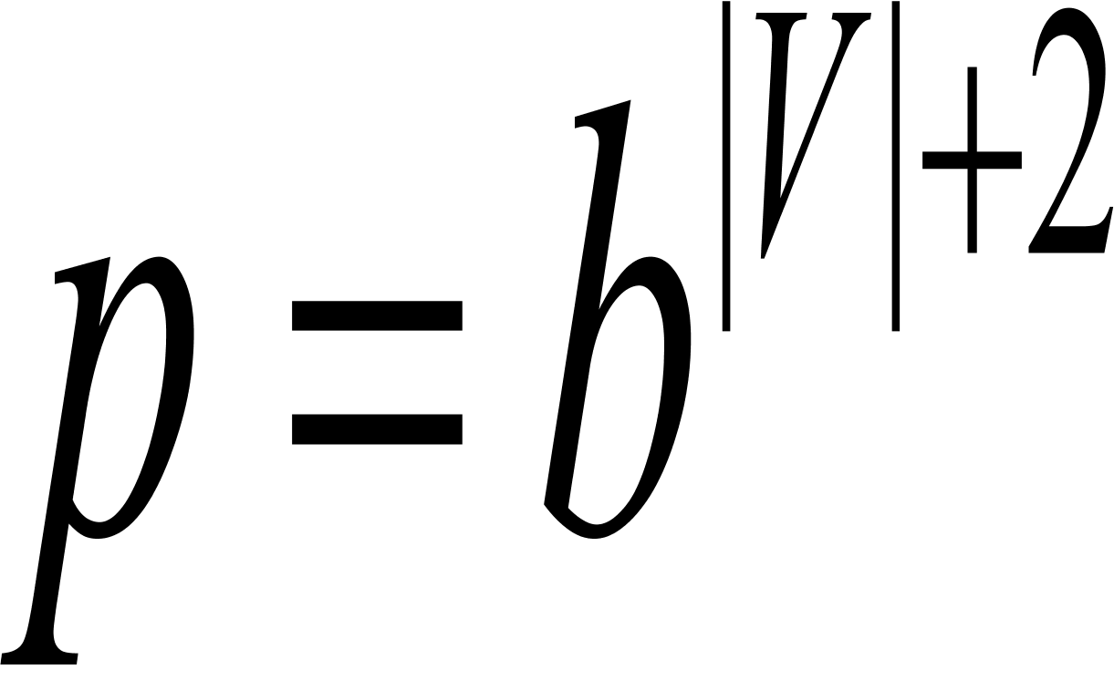
Proof Idea
T
Repeat
R
where b is the maximum number
of the descendants of a node in a
parse tree and |V| the number of
variables
R
terminals
u
v
x
y
>=p
z
T
T
R
R
R
x
u
v
R
y
z
u
z
v
x
y

Slide 18
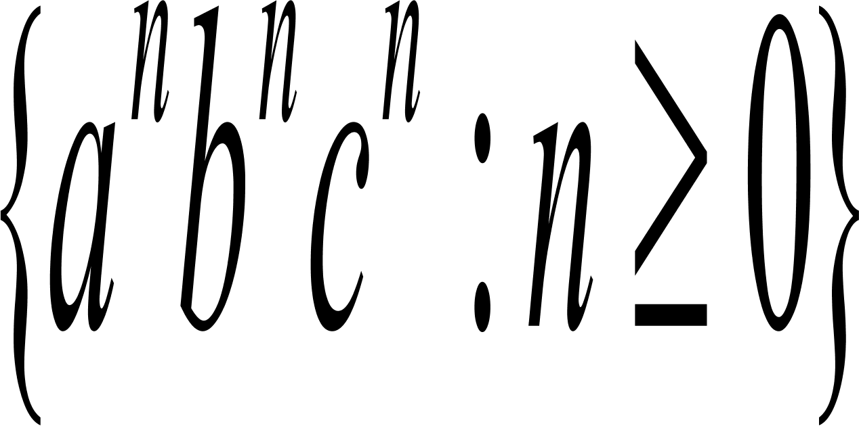
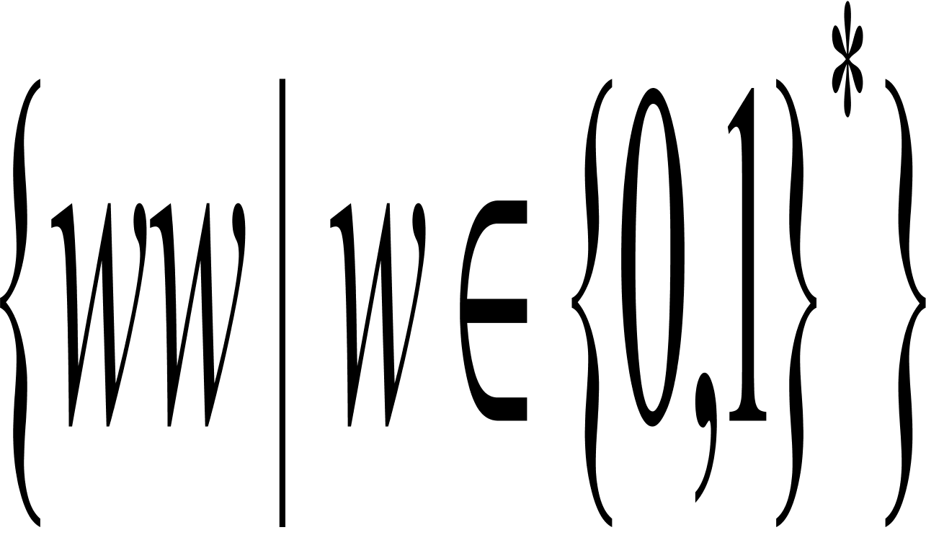
Examples: Pumping Lemma
Use the pumping lemma to show the following languages are not CFLs.
B=
C=
Can you design new kinds of natural “automata”
that “recognize” the above two languages?

Slide 19
Closure properties
The class of CFLs is closed under the regular operations, union and concatenation and star.
However, it is not closed under complement, and hence is not closed under intersection.
L1={0^n1^n2^i: n>=0,i>=0}
L2={0^i1^n2^n: n>=0,i>=0}
But the intersection of a CFL and a regular language is a CFL.
How do we prove the last statement?

Slide 20
Where are we now?
Is there an algorithm to tell whether two PDAs are equivalent?
NO!
CFL
Regular
languages
Computable
Exercises Ex 2.12, 2.18, 2.30(a)(b)

